Slide 1
Trust the Process:
Patient Management
(with a twist)
Andrei Stancu

Slide 2
From Check In to Follow-Up
1 – Check In (About Me)
2 – Check In (Self-Leadership)
3 – Assessment (Leadership Theory)
4 – Treatment (Inclusive Leadership)
5 – Outcome (Critical Thinking)
6 – Follow-Up (Interpersonal & Org.)
7 – Thank You

Slide 3
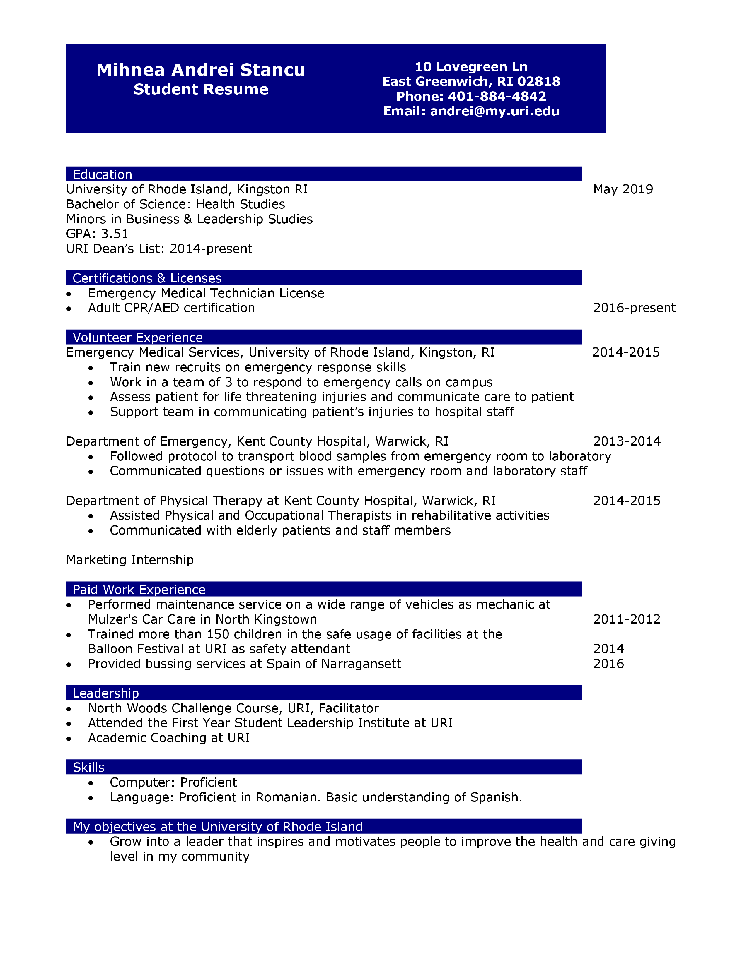
Checking In (About Me)
EMT Experience
Marketing Internship
Academic Coaching

Slide 4
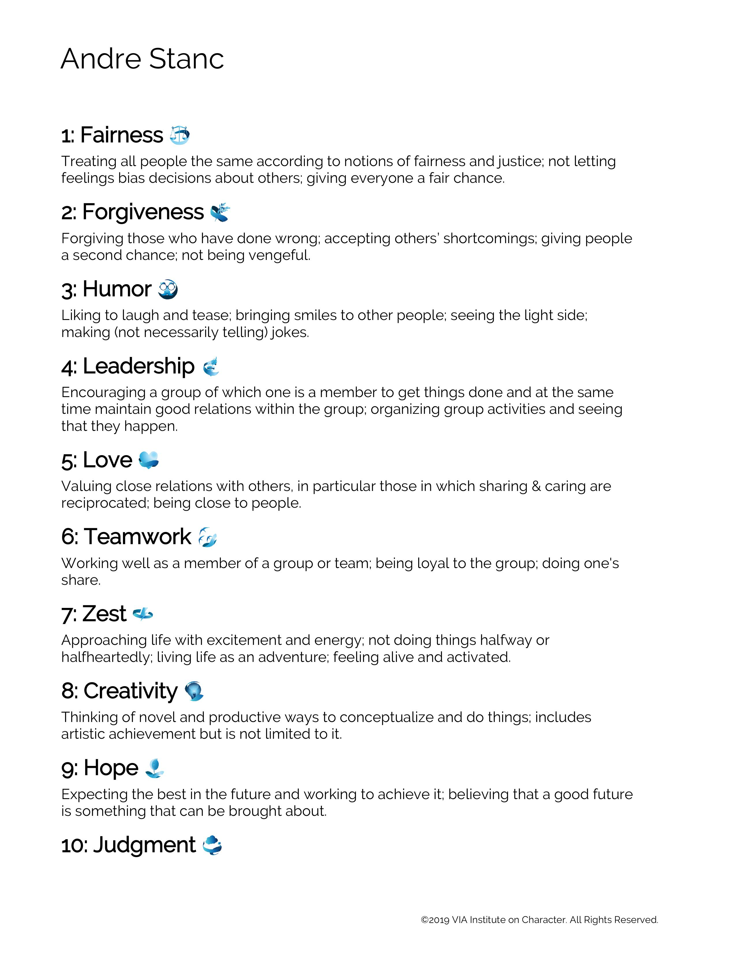
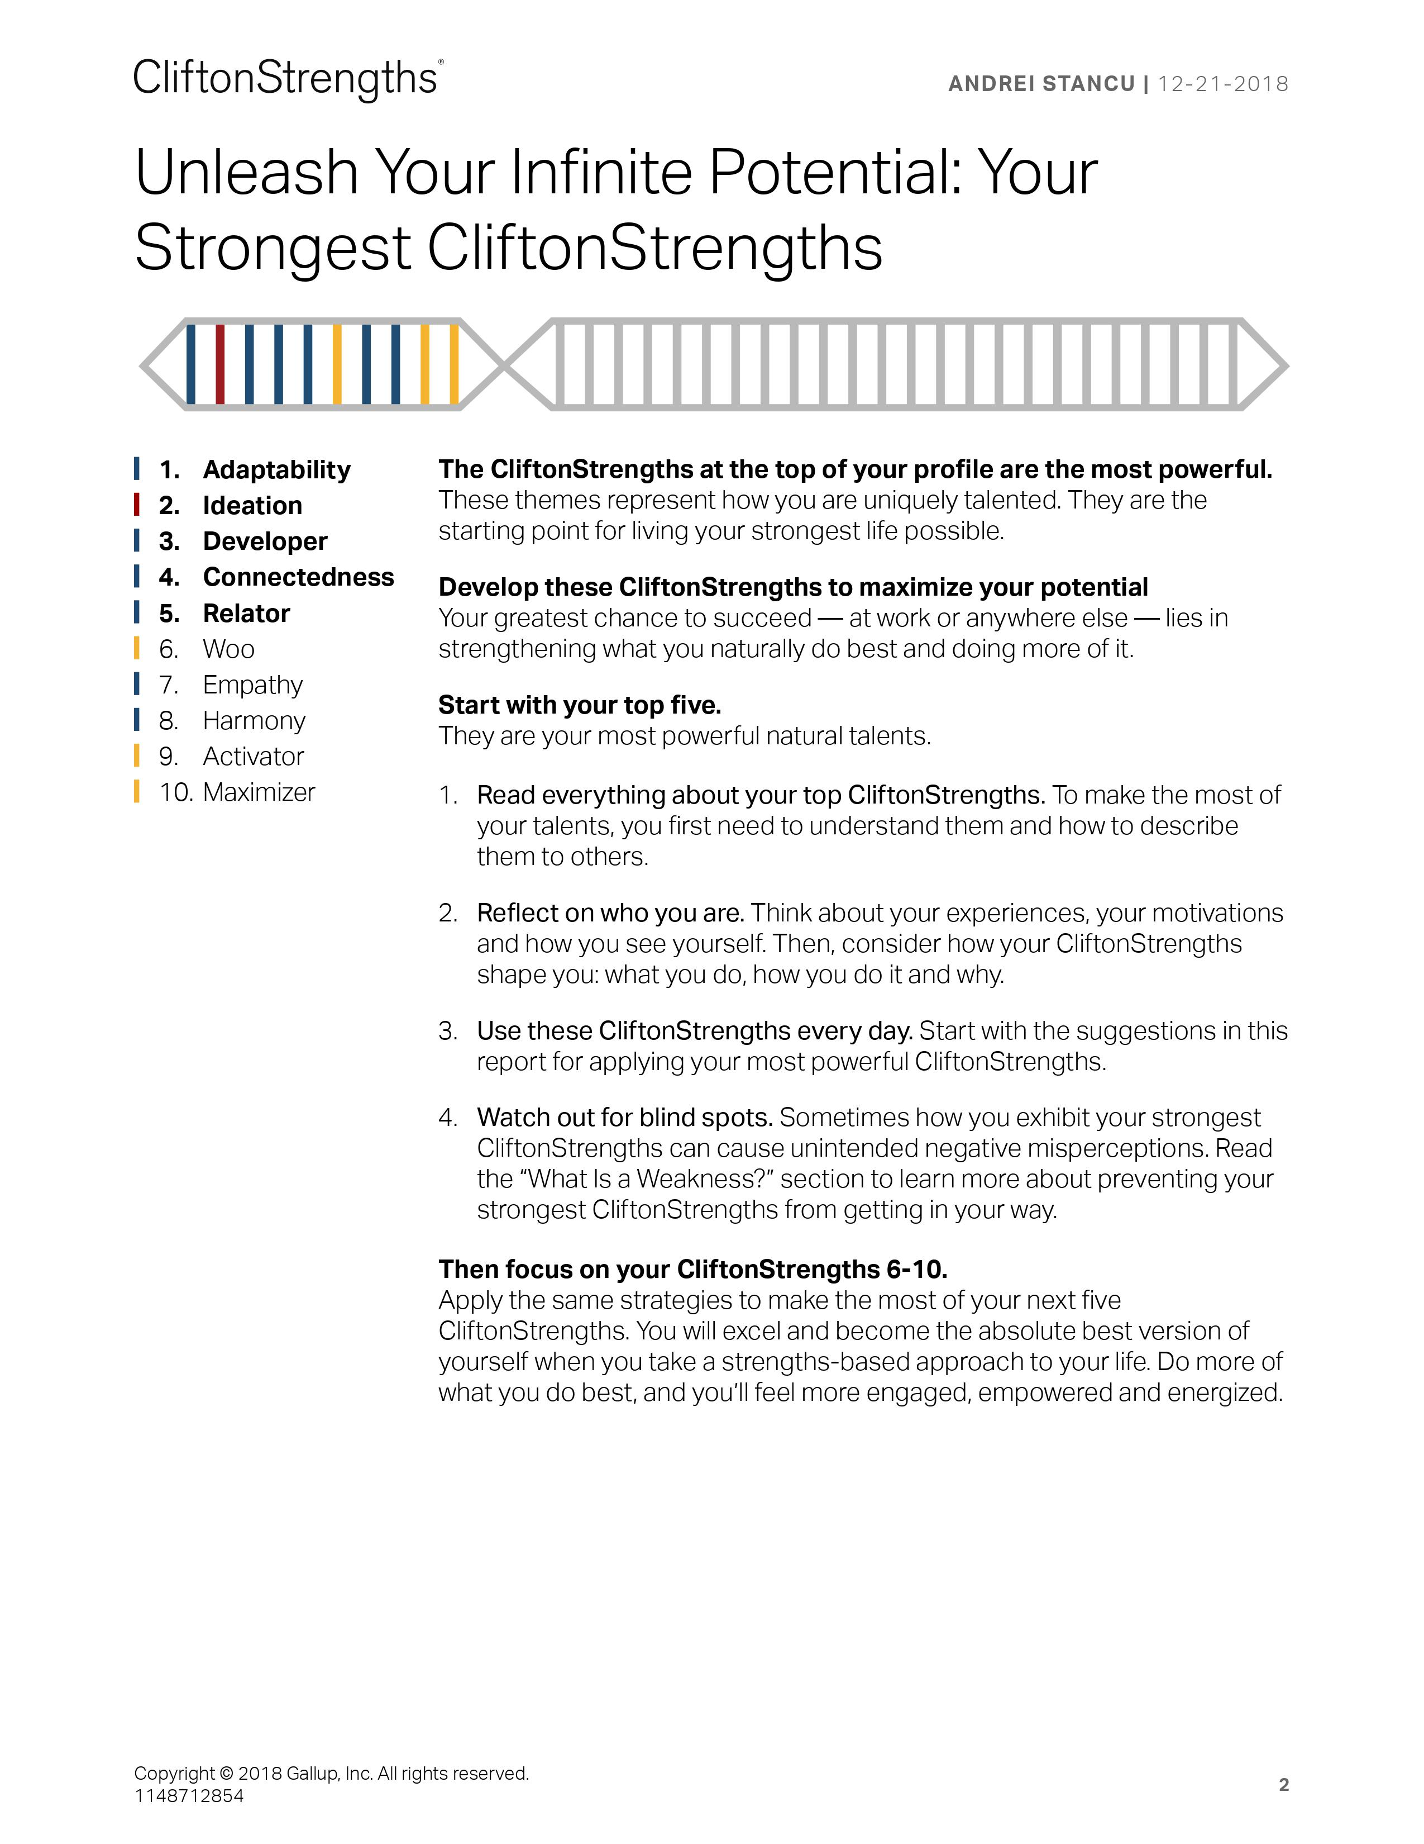
Checking In Part 2 (Self-Leadership)
Adaptability
Ideation
Developer
Relator
Connectedness
Personal Leadership Style
https://www.gallupstrengthscenter.com/

Slide 5
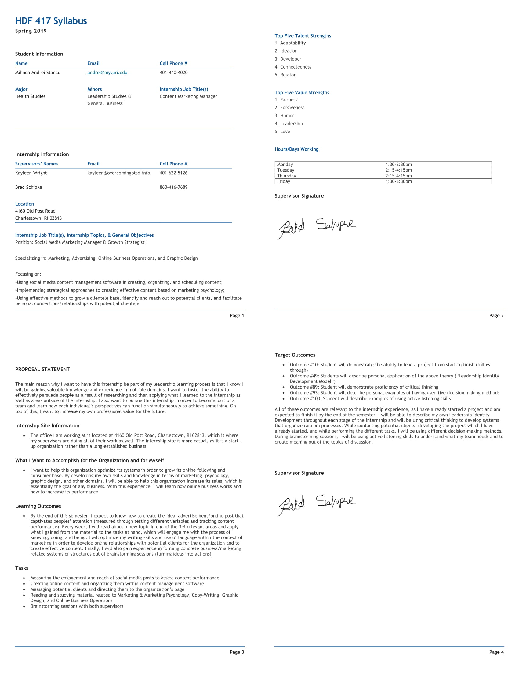
Assessment (Leadership Theory)
Principle Centered Leadership
Marketing Internship Process
Security
Identity within organization
Value of strengths
Guidance
Direction in which I make sense of things
Giving things my own meaning
Wisdom
Lead a balanced life
What I think I should do vs. reality
Power
Getting things done
Turn plans to actions
https://keithdwalker.ca/wp-content/summaries/m-p/Principal-Centred%20Leadership.Covey.EBS.pdf

Slide 6
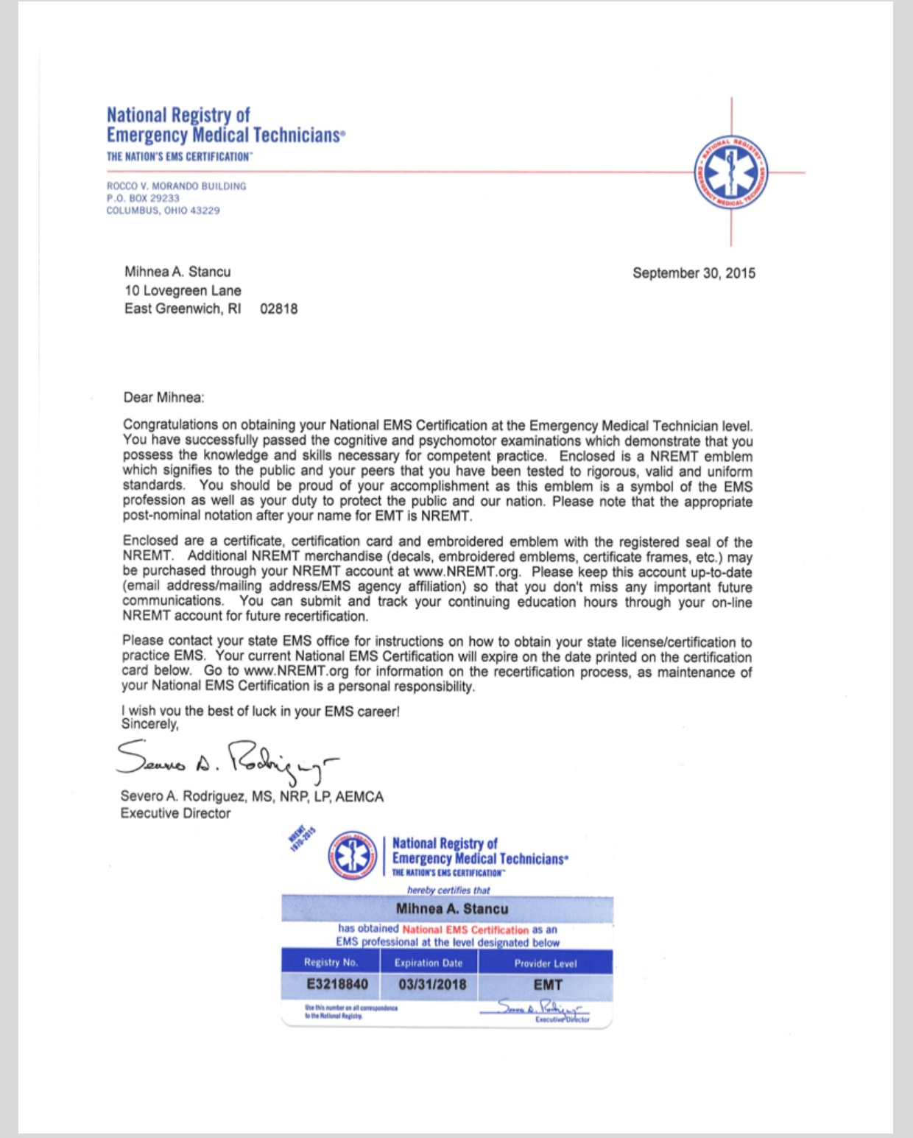
Treatment
(Inclusive Leadership/Diversity)
Change Agency
Individual
Group
Society
EMT
Social Change Model
Self-Awareness
Collective Values
Common Purpose
http://www.mu.uri.edu/leadership/pdfs/The%20Social%20Change%20Model%20of%20Leadership%20Development.pdf

Slide 7
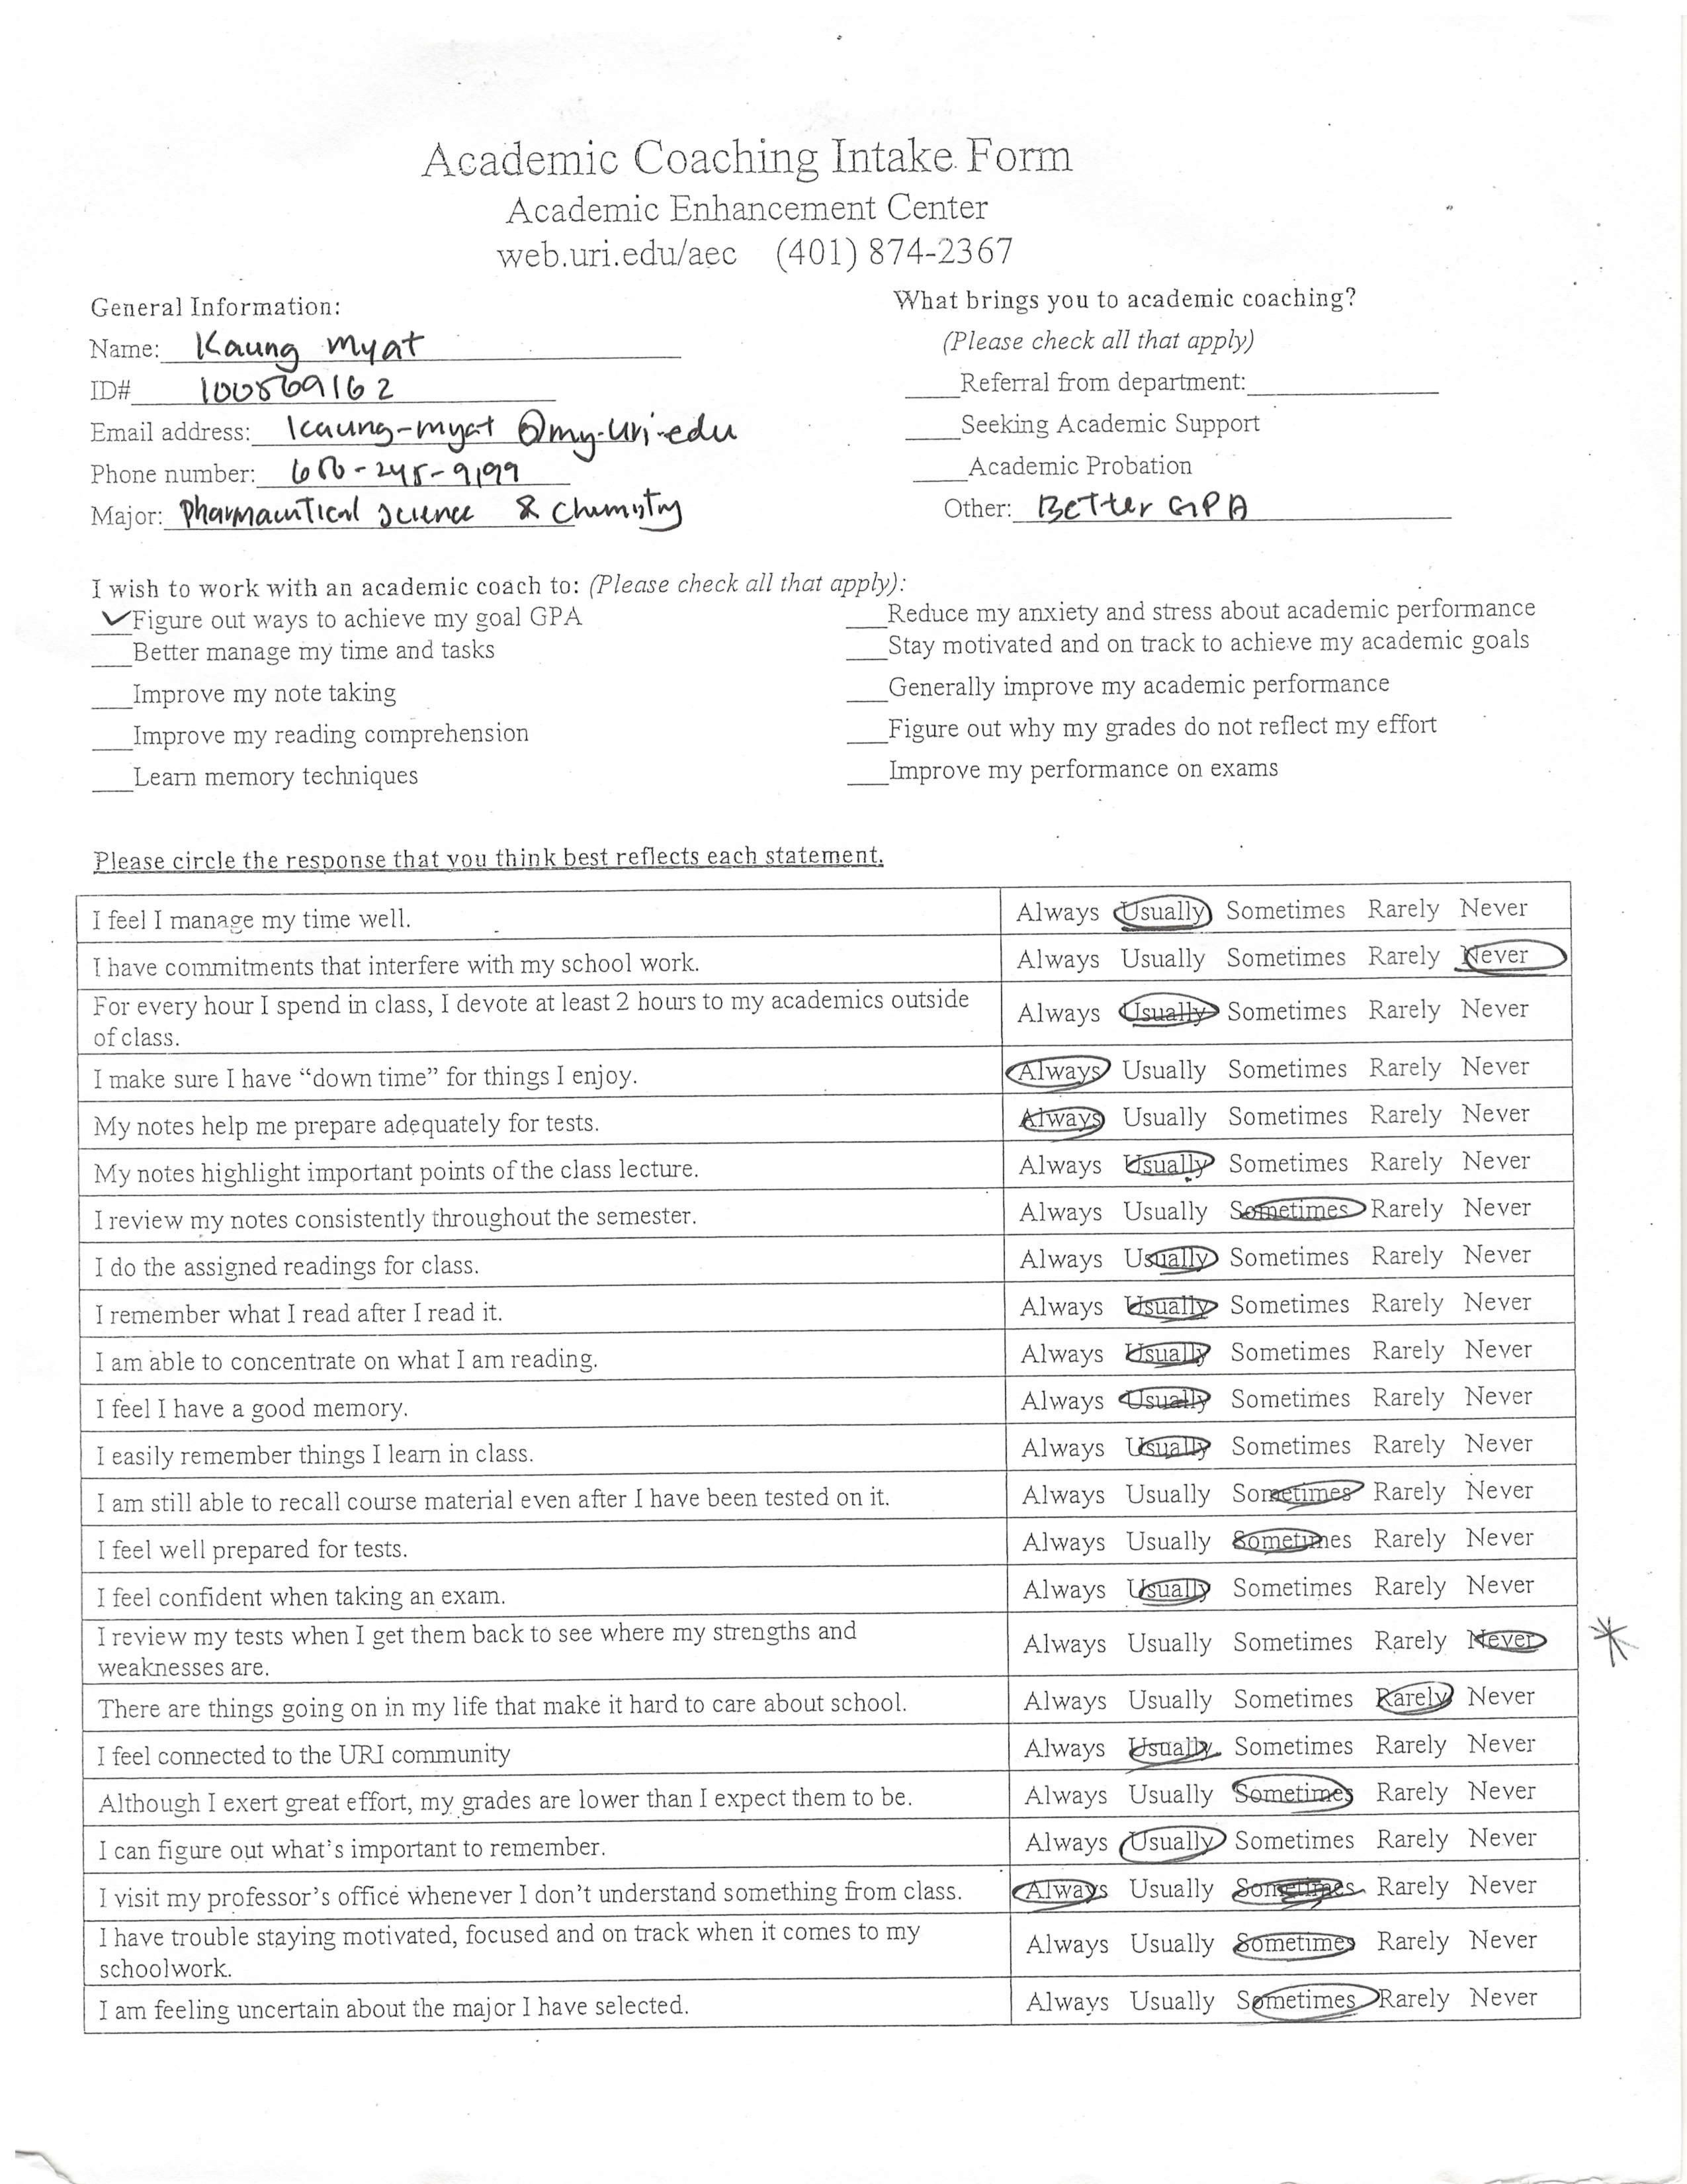
Outcome (Critical Thinking)
Analyze
Criticize
Synthesize
Utilize
Academic Coaching
Creating
Evaluation
Analysis
Application
Understanding
Knowledge
http://www.fresnostate.edu/academics/oie/documents/assesments/Blooms%20Level.pdf

Slide 8
https://www.ccl.org/multimedia/podcast/the-big-6-an-active-listening-skill-set/
Follow-Up
(Interpersonal & Organizational Leadership)
Active Listening
From old to new
Pay attention
Withhold judgment
Reflect
Clarify
Summarize
Share

Slide 9
The Patient’s Cured!
Check In
Assessment
Treatment
Outcome
Follow-Up

